Slide 1
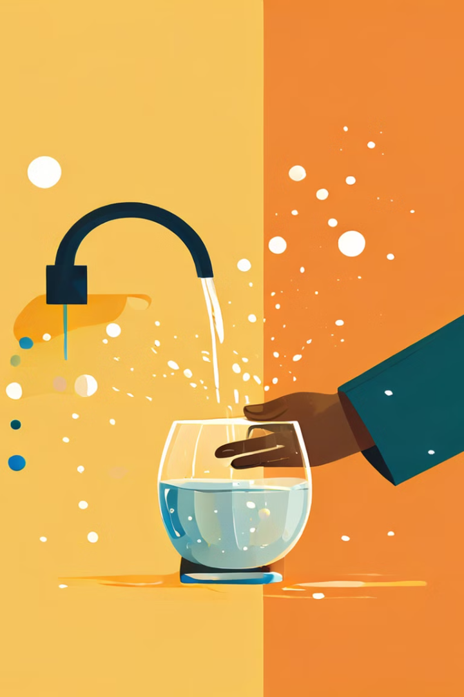
Data-Driven Solution for SDG 6: Ensuring Clean Water and Sanitation for All
This presentation outlines a data-driven approach to tackling the global challenge of providing clean water and sanitation for all.
IB
by Immaculate Bett

Slide 2

Project Overview and SDG Alignment
SDG 6 aims to ensure availability and sustainable management of water and sanitation for all by 2030.
1
Goal 6.1
2
Goal 6.2
By 2030, achieve universal and equitable access to safe and affordable drinking water for all.
By 2030, achieve access to adequate and equitable sanitation and hygiene for all and end open defecation, paying special attention to the needs of women and girls and those in vulnerable situations.
3
Goal 6.3
4
Goal 6.4
By 2030, improve water quality by reducing pollution, eliminating dumping and minimizing release of hazardous chemicals and materials, halving the proportion of untreated wastewater and substantially increasing recycling and safe reuse globally.
By 2030, substantially increase water-use efficiency across all sectors and ensure sustainable withdrawal and supply of freshwater to address water scarcity and substantially reduce the number of people suffering from water scarcity.

Slide 3
Problem Statement and Opportunity
Millions of people lack access to safe water and sanitation, leading to health risks, poverty, and economic hardship.
Challenges
Opportunities
Lack of infrastructure, inadequate water management practices, pollution, and climate change.
Data analytics can help optimize water resource management, identify pollution sources, and develop effective interventions.

Slide 4

Database design and schema
We will utilize variety of data sources, MSQL Schema and excel work book
Data Source
Description
Creating tables and analysis for monitoring water quality, identifying pollution sources and contamination and possible health cases
MYSQL
Data collection
Collecting real-time data on water flow, levels, and quality.
Government Databases
Providing demographic information, water usage patterns, and infrastructure data.

Slide 5




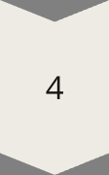
Proposed Solution
My project proposed a data-driven approach to improve water management and sanitation through the use of advanced analytics and machine learning.
Step 1
Data Collection and Integration
Step 2
Data Analysis and Modeling
Step 3
Developing Insights and Recommendations
Step 4
Implementation and Evaluation

Slide 6





Anticipated Impact and Key Metrics
Our project aims to improve access to clean water and sanitation, reducing waterborne diseases and promoting public health.
Reduced Waterborne Diseases
Improved Water Quality
Enhanced Environmental Sustainability
Improved Quality of Life
Our project aims to improve water quality by identifying and addressing pollution sources.
Access to clean water and sanitation can improve living conditions and promote economic development.
By improving access to clean water and sanitation, we expect to see a significant reduction in waterborne diseases.
Sustainable water management practices can help protect ecosystems and biodiversity.

Slide 7

Sustainability and Scalability
Our project is designed to be sustainable and scalable, ensuring long-term impact and benefit.
1
Phase 1
Pilot Implementation in Selected Communities
2
Phase 2
Data-Driven Optimization and Refinement
3
Phase 3
Expansion to Wider Geographic Areas

Slide 8

Conclusion and Call to Action
Our data-driven approach offers a powerful solution to address the global challenge of ensuring clean water and sanitation for all.
Join the Movement
Get Involved
Support our initiative and contribute to a sustainable future for all.
Partner with us to implement this project and make a real difference in the world.

Slide 9
